Slide 1
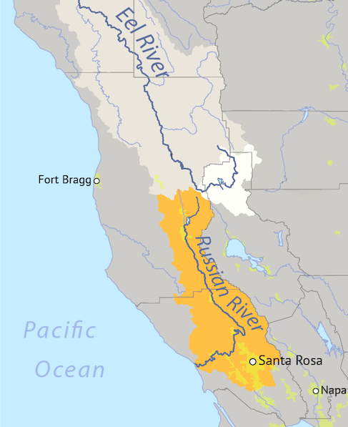

New Eel Russian Facility Update
David Manning
Executive Director, Eel-Russian Project Authority
August 2025

Slide 2
Introduction to the Potter Valley Project
Currently owned by PG&E, has diverted water from the Eel River to the Russian River since 1908.
Historic diversions have been year-round for hydropower.
The Project has adversely affected anadromous fisheries, environmental quality, and related beneficial uses of water in the Eel River Basin.
Water diverted from the Eel to Russian River has supported agriculture, communities, and the environment for more than 100 years.
In 2019, PG&E announced intent to stop operating the project as no longer economically feasible.
By July 29, 2025 PG&E will file License Surrender Application.
Russian River & Eel River interests implementing a plan of action.

Slide 3
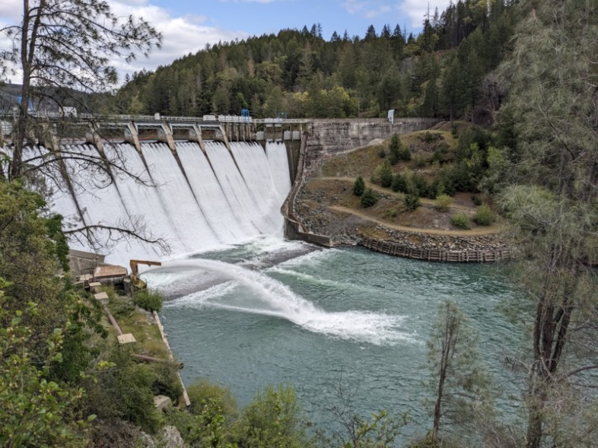
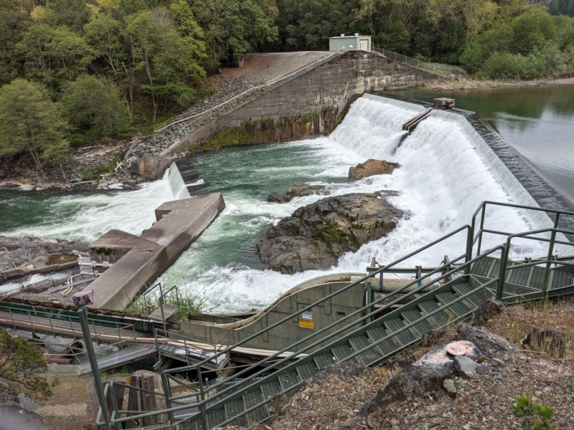
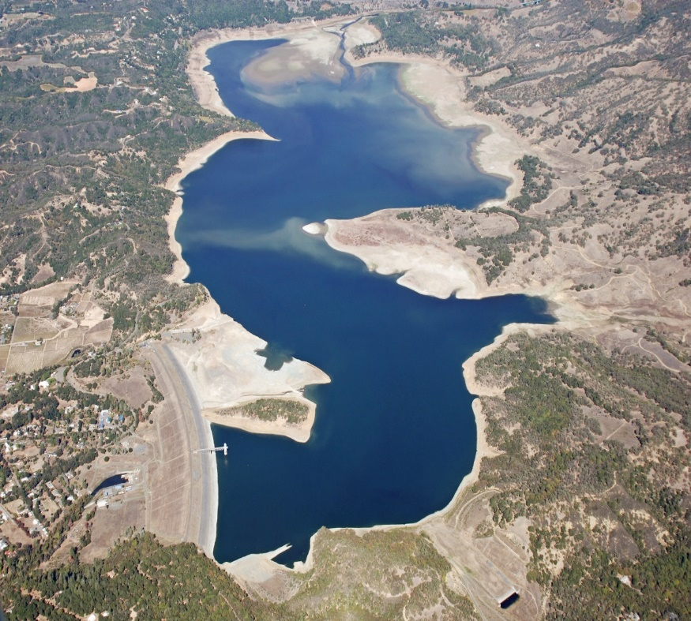
Scott Dam & Lake Pillsbury
Cape Horn Dam & Van Arsdale Reservoir
Coyote Valley Dam & Lake Mendocino

Slide 4
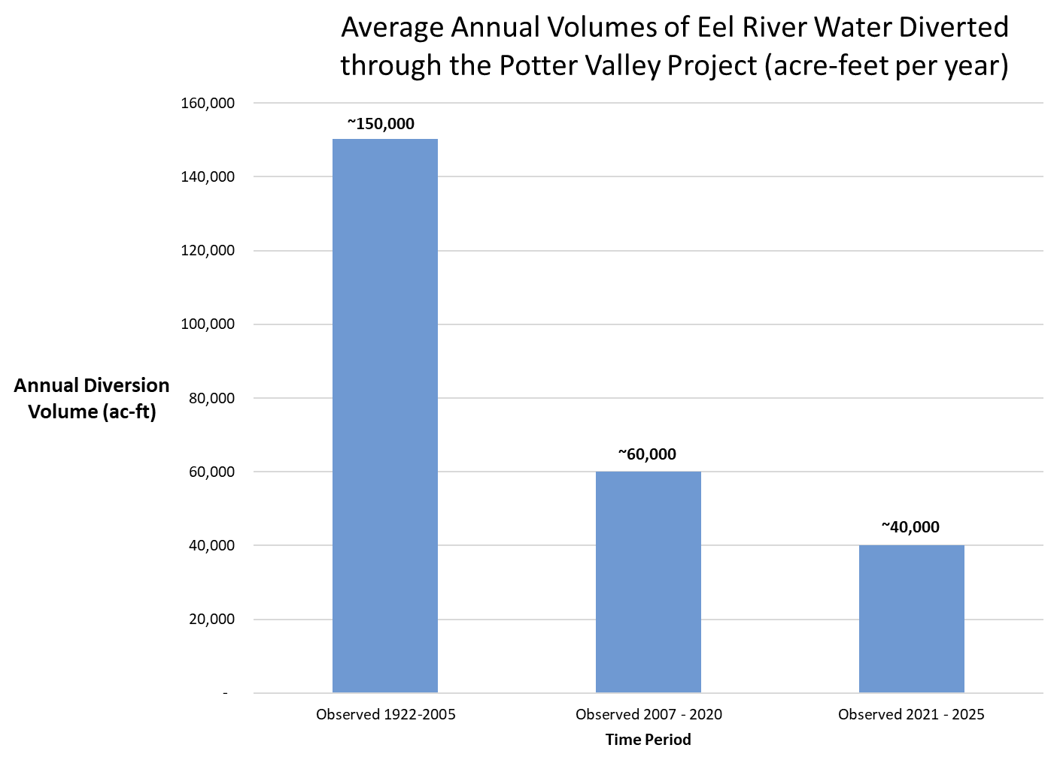

Slide 5

Two-Basin Partnership
Improve fish migration and habitat on the Eel River with the objective of achieving naturally reproducing, self-sustaining, and harvestable native anadromous fish populations; and
Maintain continued water diversion from the Eel River through the existing tunnel to the Russian River to support water supply reliability, fisheries, and water quality in the Russian River Basin.

Slide 6

Eel-Russian Project Authority
In December 2023, Sonoma Water, Sonoma County, and Mendocino County IWPC formed ERPA as a joint powers authority. RVIT has a seat on ERPA’s Board of Directors.
ERPA proposes to construct, operate, and maintain a New Eel-Russian Facility to divert water from the Eel River, at the site of and following the decommissioning and removal of Cape Horn Dam, on terms consistent with restoration of the anadromous fisheries of the Eel.

Slide 7
Cape Horn Dam Background

Slide 8
New Eel Russian Facility (NERF)

Slide 9
New Eel Russian Facility (NERF)

Slide 10
New Eel Russian Facility Diversion Rules
Developed by RVIT (Applied River Sciences)
 | Fall Flows* | Winter Flows | Spring Flows | Summer Flows
Date Range: | Oct 1 – Dec 31 | Jan 1 – Feb 29 | Mar 1 – May 31 | Jun 1 – Sep 30
Floor: | 300 cfs | 250 cfs | 125 cfs | 35 cfs
Maximum Diversion Rate: | 20% | 30% | 20% | 20%
Ramping Rates | To protect floor, NERF hits Maximum Diversion Rate (20%) When Eel River flow is 375 cfs | To protect floor, NERF hits Maximum Diversion Rate (30%) When Eel River flow is 357 cfs | To protect floor, NERF hits Maximum Diversion Rate (20%) when Eel River flow is 156 cfs | To protect floor, NERF hits Maximum Diversion Rate (20%) when Eel River flow is 43.75 cfs
Maximum Diversion Capacity | 300 cfs | 300 cfs | 300 cfs | 300 cfs

Slide 11
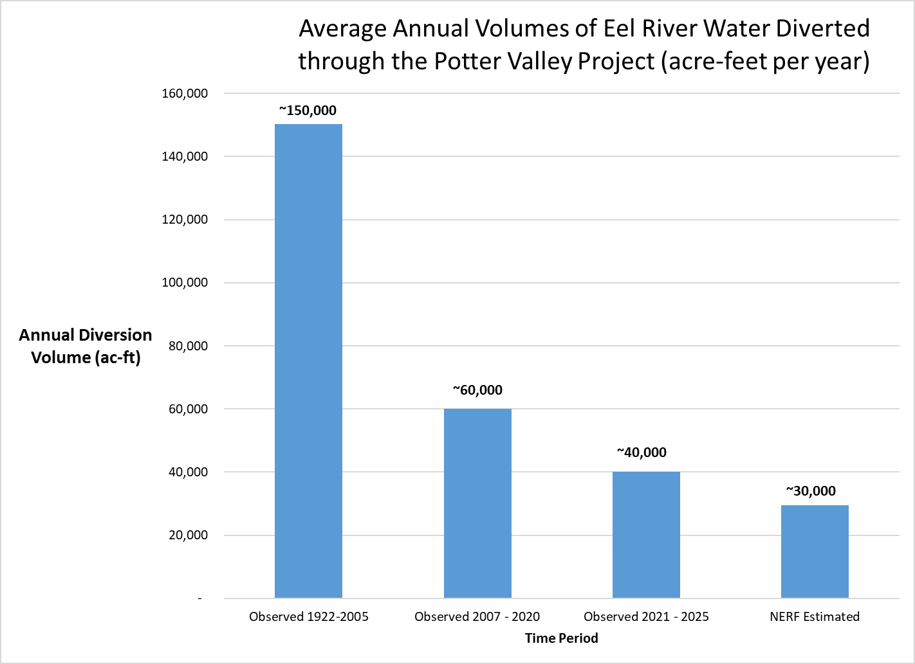
Approx. NERF estimate constrained by available Lake Mendocino storage

Slide 12
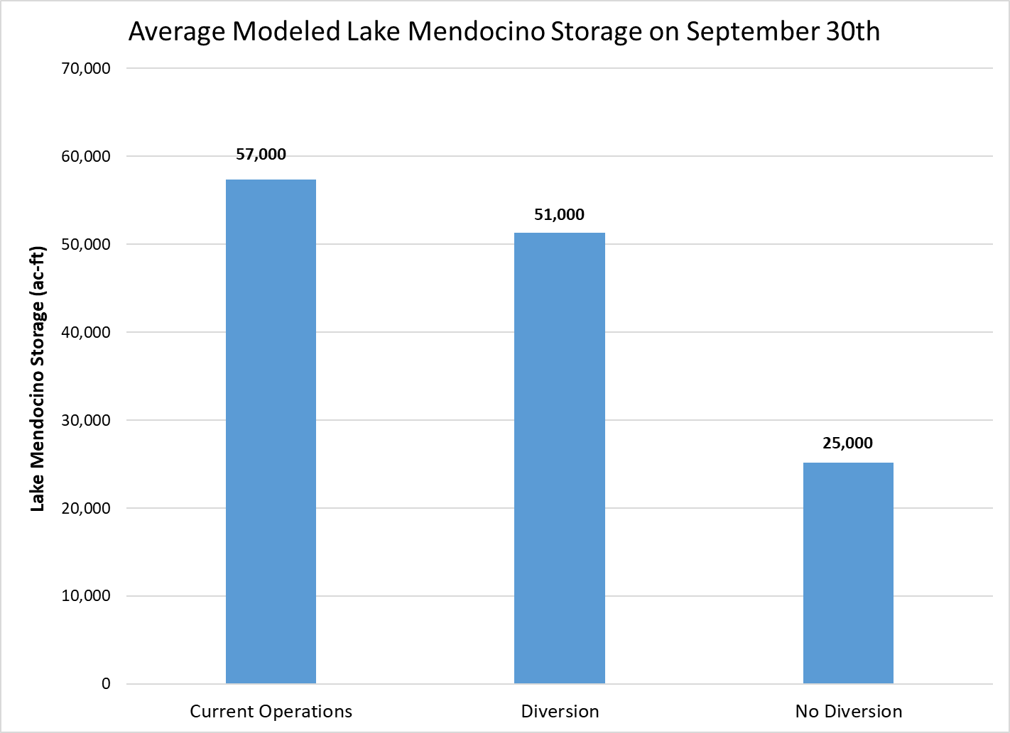

Slide 13
New Eel-Russian Facility CEQA Process
ESA PowerPoint Colors
PRIMARY
Scope of Work in development anticipating Environmental Impact Report (EIR) preparation covering project construction, operations, and maintenance
  Will include multiple opportunities for public and agency input during process
  Initial work to:
    Clarify New Eel-Russian Facility Project Description and Objectives
    Distinguish from PG&E project
    Identify future diversion scenarios
  Organize, synthesize existing information and identify studies needed for environmental compliance
  Technical analyses for hydrology, biological resources, cultural resources, recreation, agriculture, others
  Project-specific and cumulative effects
#1193BA
#66CAD8
The primary colors are the main colors that should be used in our presentations.
#7F7B7A
#004562
USE SPARINGLY
These colors act as a complementary color palette to the primary colors. When used they should not consist of more than 20% of the overall design.
Use Eyedropper to incorporate these colors:
Select shape/text;
Under Shape Format tab, click Shape Fill, choose Eyedropper;
With eyedropper, click on color you’d like to match

Slide 14
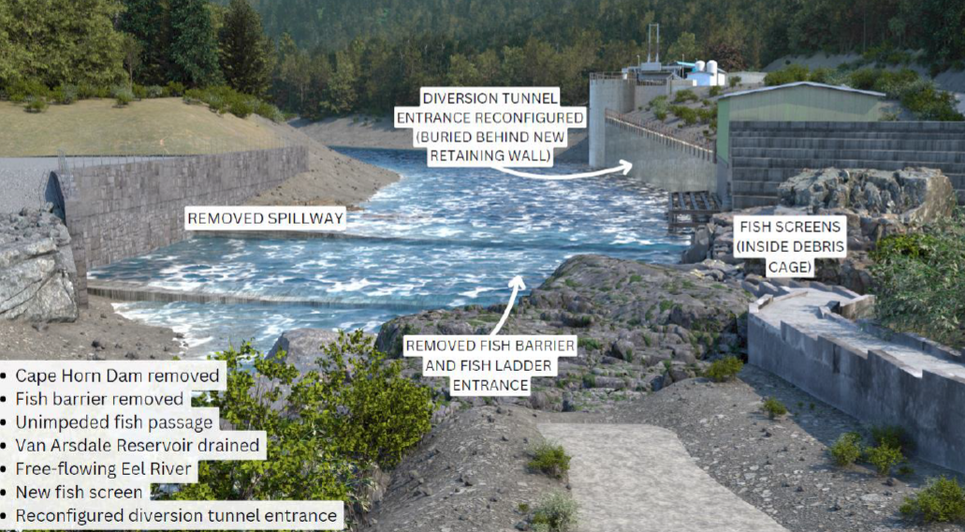
New Eel-Russian Facility CEQA Process
ESA PowerPoint Colors
Close coordination with ERPA member agencies, State Water Board and other agencies to complete studies on schedule, keeping pace with PG&E license surrender environmental review
Timeline approximately 24 months once initiated
PRIMARY
#1193BA
#66CAD8
The primary colors are the main colors that should be used in our presentations.
#7F7B7A
#004562
USE SPARINGLY
These colors act as a complementary color palette to the primary colors. When used they should not consist of more than 20% of the overall design.
Use Eyedropper to incorporate these colors:
Select shape/text;
Under Shape Format tab, click Shape Fill, choose Eyedropper;
With eyedropper, click on color you’d like to match

Slide 15
ERPA/NERF Next Steps and Potential Schedule
PG&E License Surrender Application filed with FERC by July 29, 2025
All Parties Sign Water Diversion Agreement by July 29, 2025
2025-2028
  ERPA Business Plan
  NERF 60%-90% design
  ERPA CA Environmental Quality Act (CEQA) for NERF
  U.S. Army Corps Of Engineers NEPA for ERPA Clean Water Act Compliance
  National Marine Fisheries Service (NMFS) Biological Opinions for NERF construction and operations
2028-2030
  ERPA Final Engineering, Permits, Bidding, Contracting
2030-2035
  NERF Construction

Slide 16

ERPA Communications Coordinated with Partner Agencies
Providing information to the public:
Project related background information
Past timelines and estimated schedules
Topical informational Fact Sheets
  NERF / ERPA overview
  Explaining how new diversion would affect Russian River water supply
  Explaining how Water Diversion Agreement rules work and how they protect Eel River ecosystem
Robust information on ERPA website
Respond to media inquires

Slide 17
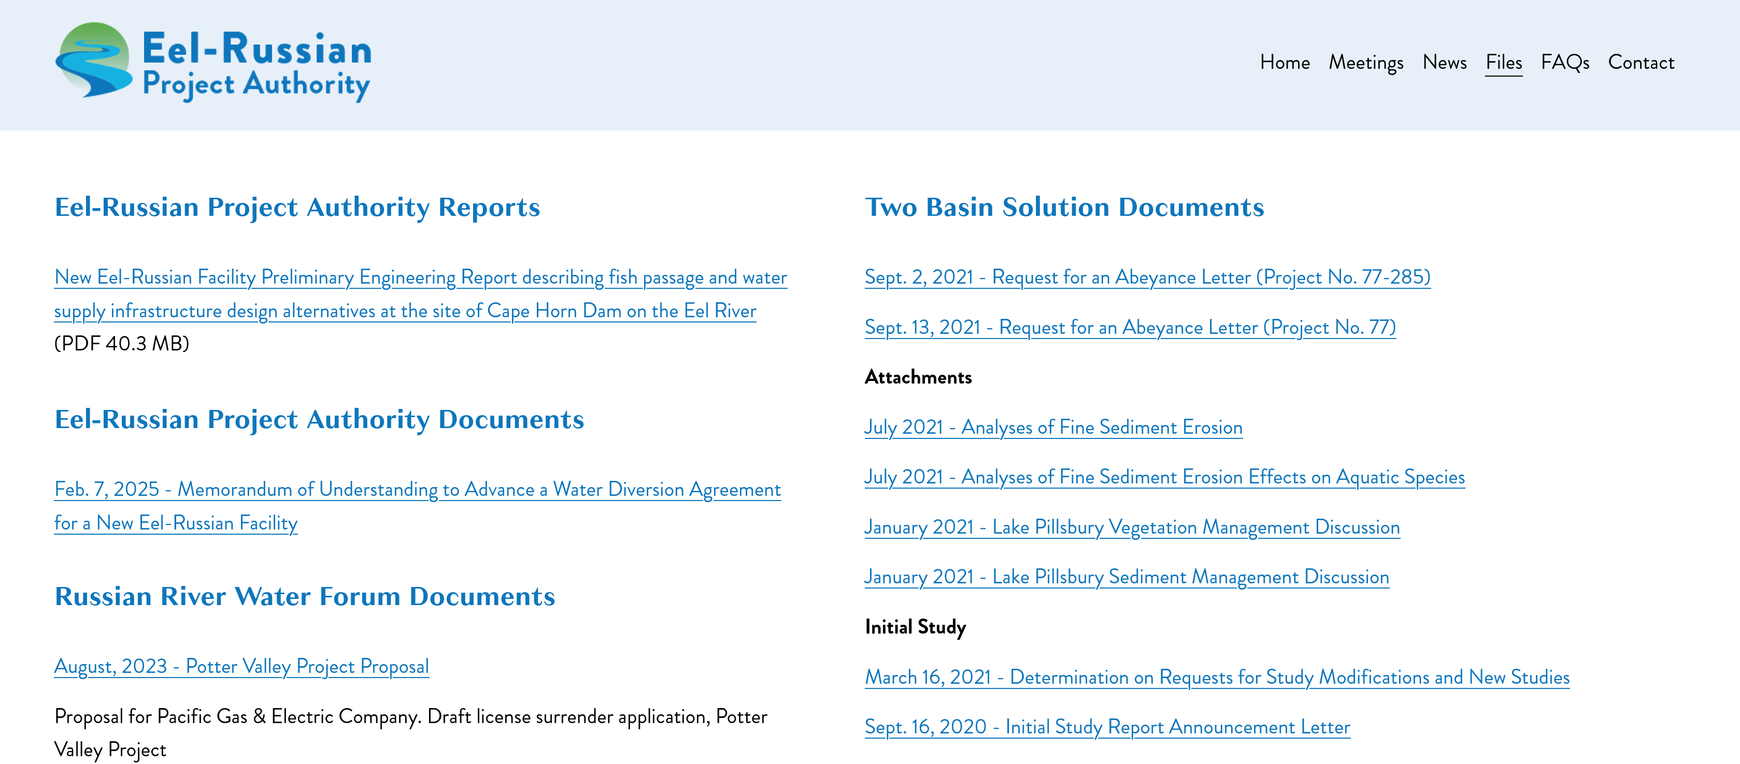
Website provides in-depth information on how we got here

Slide 18
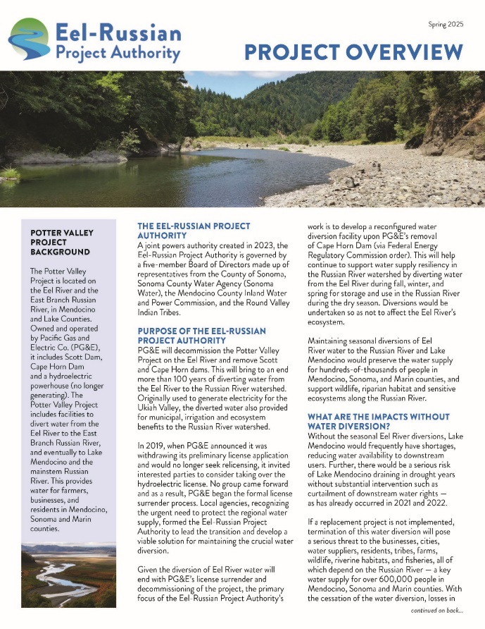
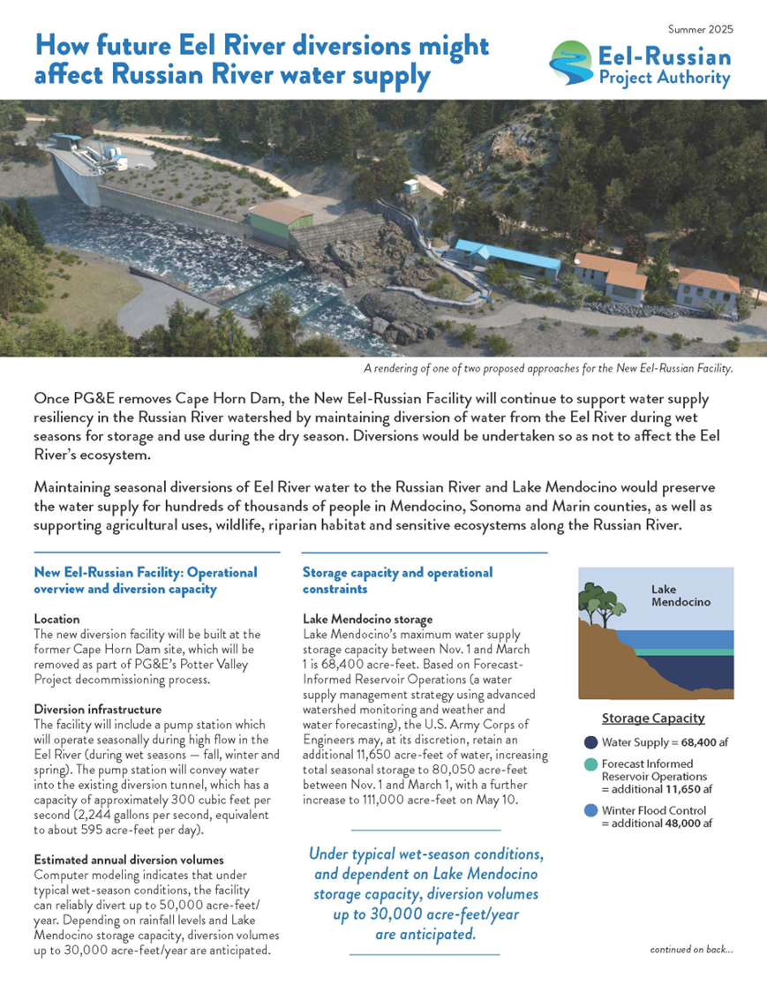
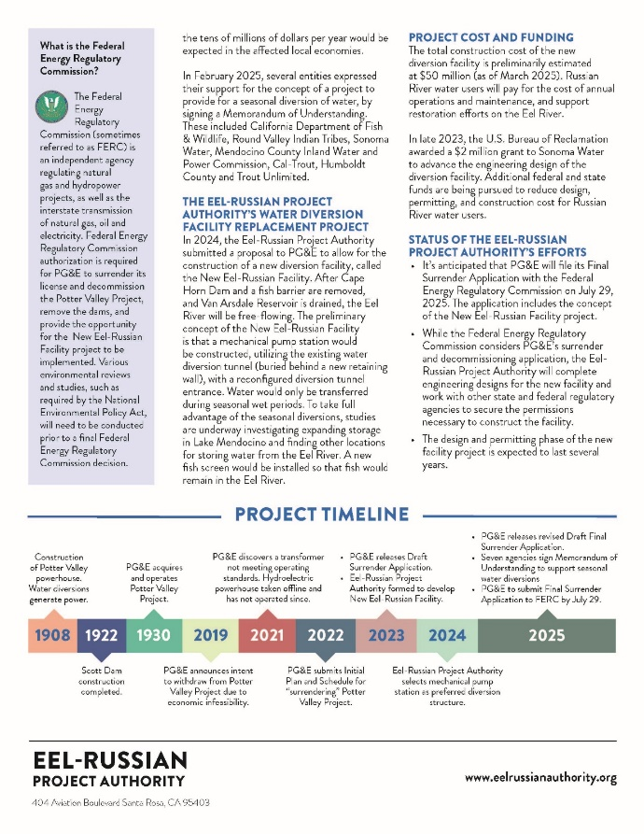
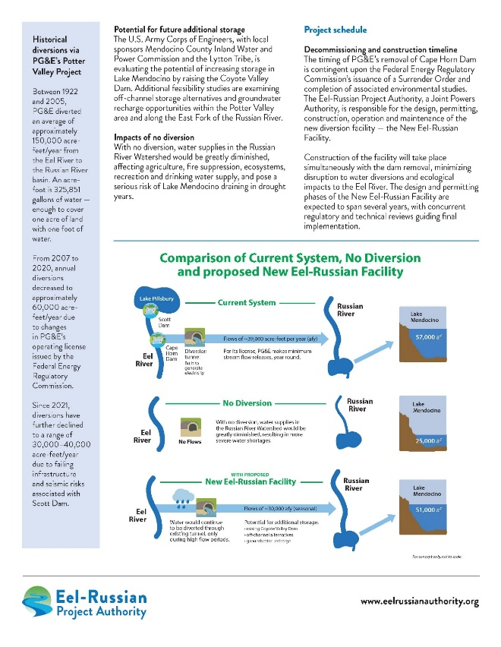
ERPA Fact-Sheets

